Slide 1


TheWebConf2022
Commutativity-guaranteed Docker Image Reconstruction towards Effective Layer Sharing
Sisi Li, Ao Zhou, Xiao Ma, Mengwei Xu, Qingyuan Jiang, Shangguang Wang
Beijing University of Posts and Telecommunications
1

Slide 2



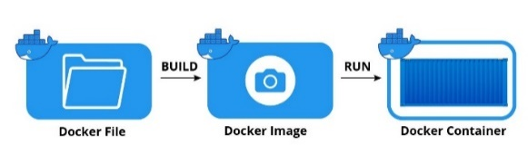

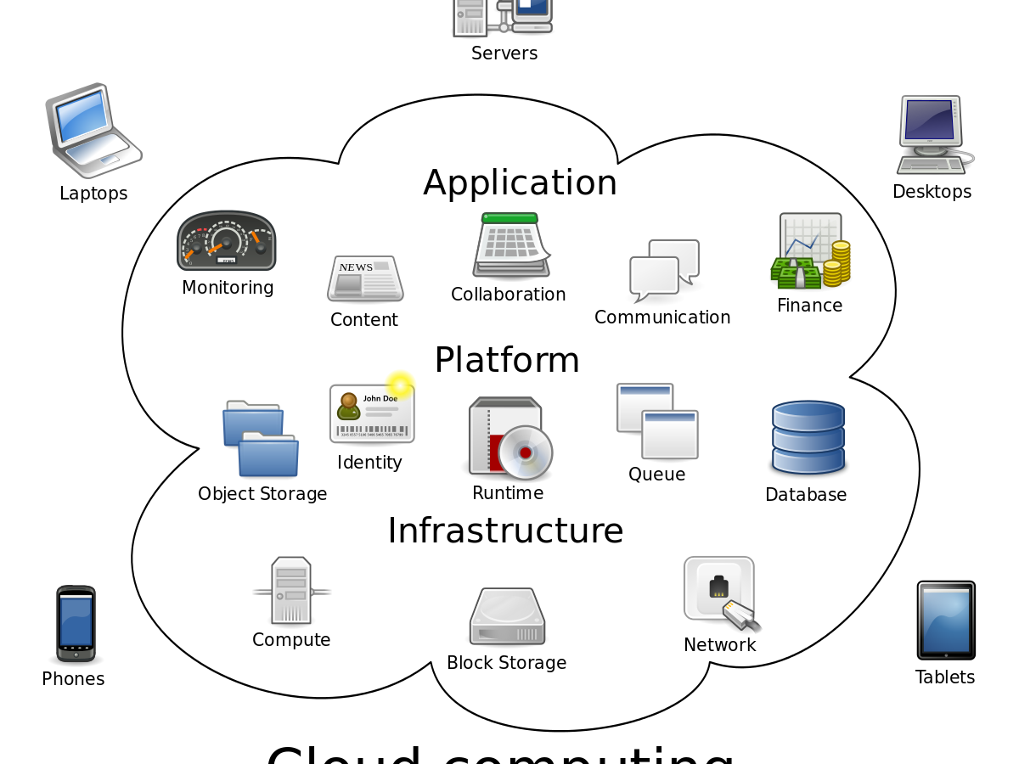
Background
Container
Application deployment evolvement with containers.
IBM Cloud Functions
Azure Functions
Knative
Alibaba Cloud
Openwhisk
Image
Rapid growth of container images.
E.g.: Docker Hub stores more than 2 million public images occupying 1 PB storage.
BUILD
RUN
Docker file
Docker image
Docker container
Service
Frequent service deployment and migration.
E.g.: Google starts average 7,000 containers per second.
Communication
Monitoring
Content
Finance
Identification
Computing
2
Notes:
逻辑问题

Slide 3


















Background
Container
Huge pressure on storage and network of container images.
Image
Communication
manufacturing
Access
Image transmission
Transaction
Authority
Runtime
Management
Service
Identification
Image registry
Storage
Database
Analysis
Video
Payment
How to relieve the burden of storage and network caused by container images?
3
Notes:
图片补充

Slide 4






Content Addressable Storage (CAS)
CAS used in Docker benefits to both storage and network!
CAS allows identical layer sharing among different images at the local storage.
“Tags”: [java: latest],“Image”: sha256:f5b050f177fd426be”,
“Layers”: [“sha256: 987ghtbf6gs8”,
“sha256: kijl09h7jnw9”,
“sha256: jh75g8hu954f”]
……
Exist at local!
Not at local!
Not at local!
check
clients
server
Image registry
containers
local storage
4

Slide 5
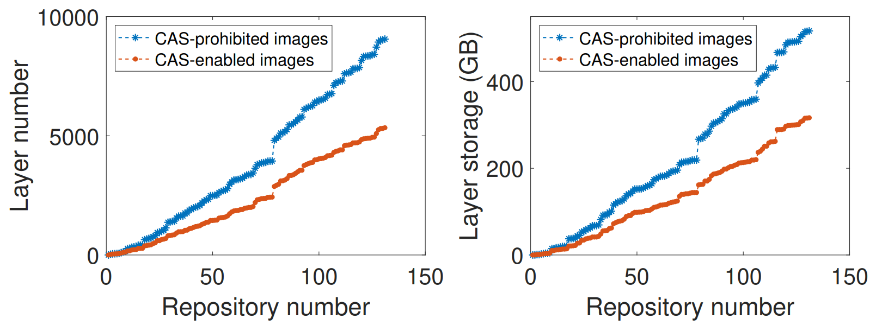
Evaluation of Content Addressable Storage
ImageNet: 2,200 images including 8,305,000 files among the most popular 130 repositories from Docker Hub.
44% layer decline
38%
storage saving
The saving gets larger with the increase of repositories.
5
Notes:
Dataset名字

Slide 6
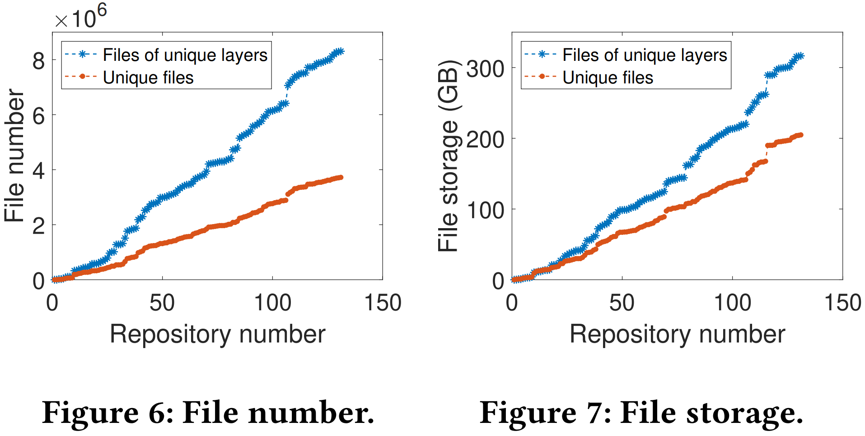
Image File Redundancy
35% redundant storage
55.2% duplicated files
The redundancy gets larger with the increase of repositories.
Layer sharing enables partial files reused, while can not eliminate all the file redundancy. The potential of layer sharing remains to be explored.
6

Slide 7
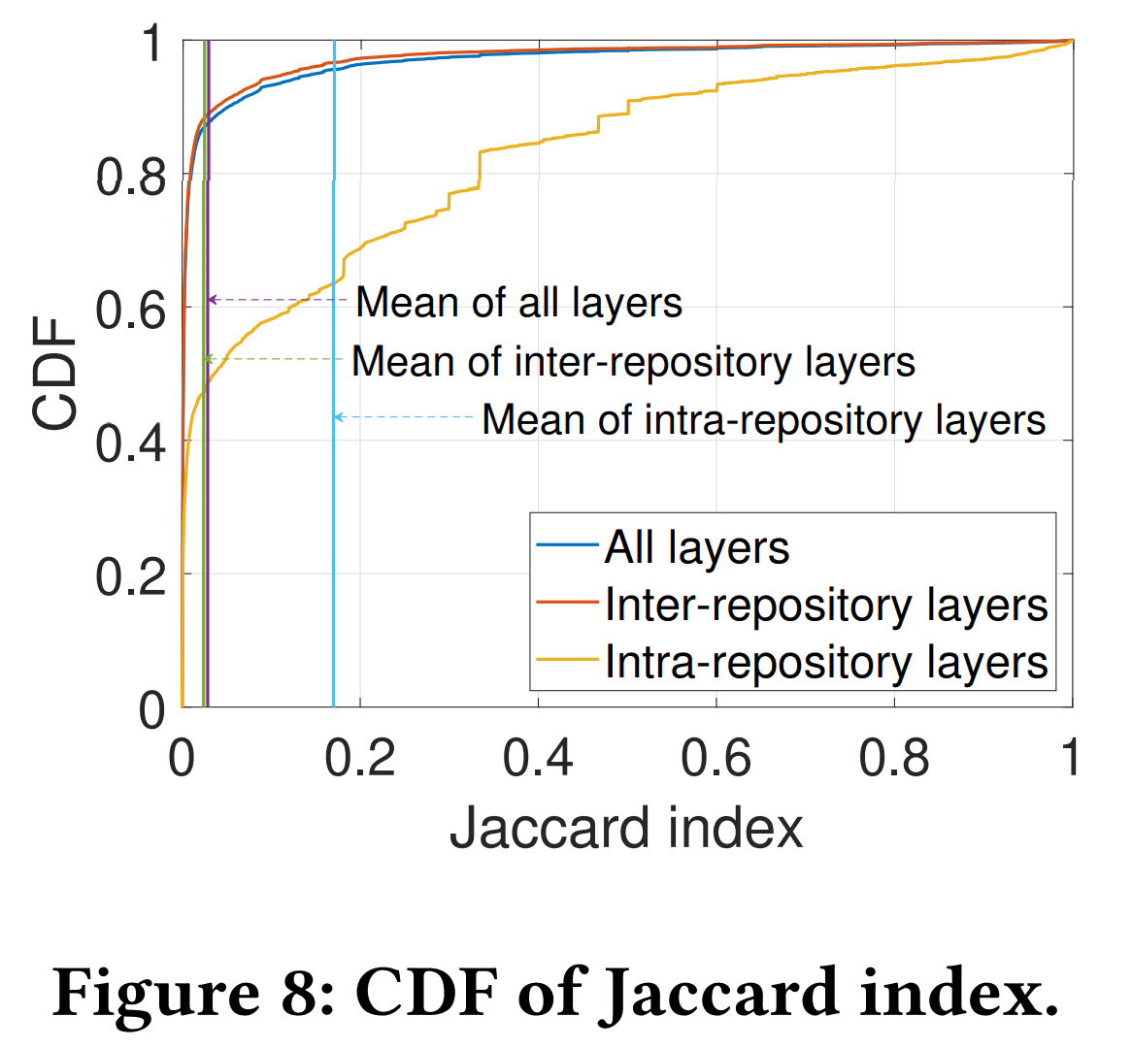
Image Layer Similarity
How many layers are similar?
Layer similarity: the level of file redundancy between layers
Quantification metrics:
Jaccard index
Deduplication ratio
More identical files
0 1
More redundant storage
1 2
Not all layers have identical files. (Jaccard index = 0)
Partial layers have high proportion of identical files. (Jaccard index > 0.7)
7
Notes:
观点不够明确

Slide 8
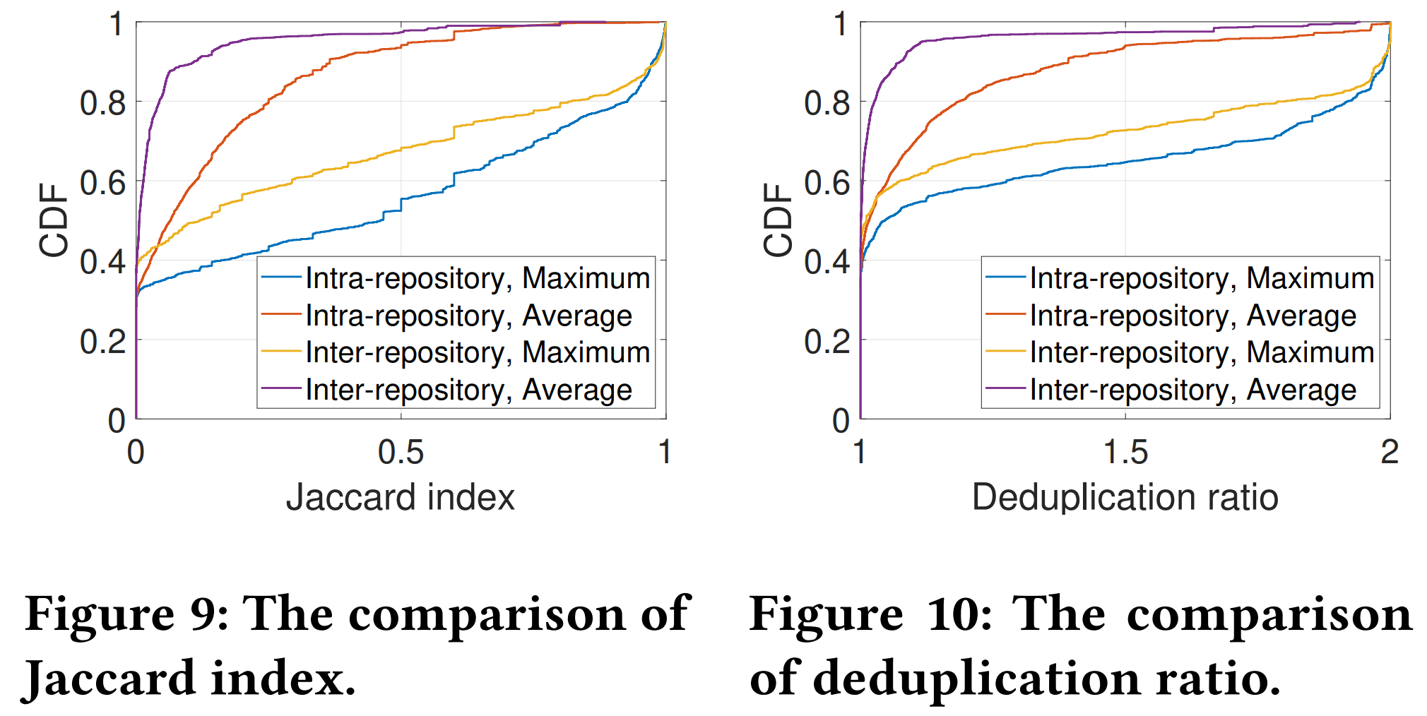
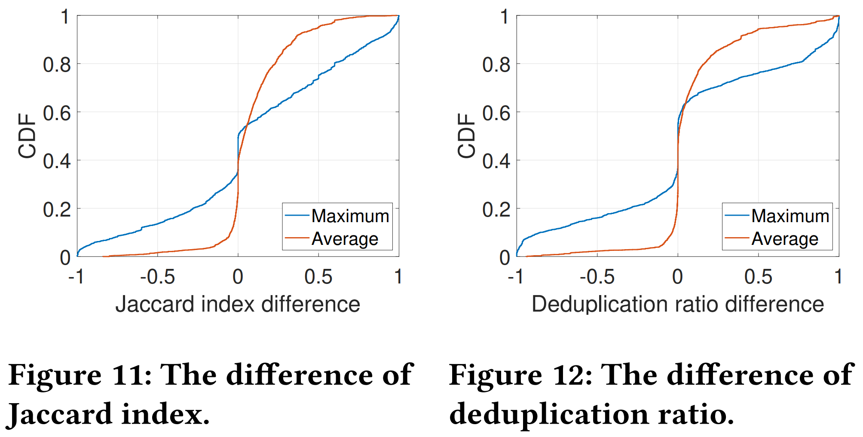
Image Layer Similarity
How much similar are layers within repository and across repositories?
(0.8,0.72)
(0.8,0.79)
Layers within the same repositories are more similar than layers across the repositories.
(0,0.32)
Metric difference of the layer: maximum/average metric within repository
- maximum/average metric across repository
8

Slide 9

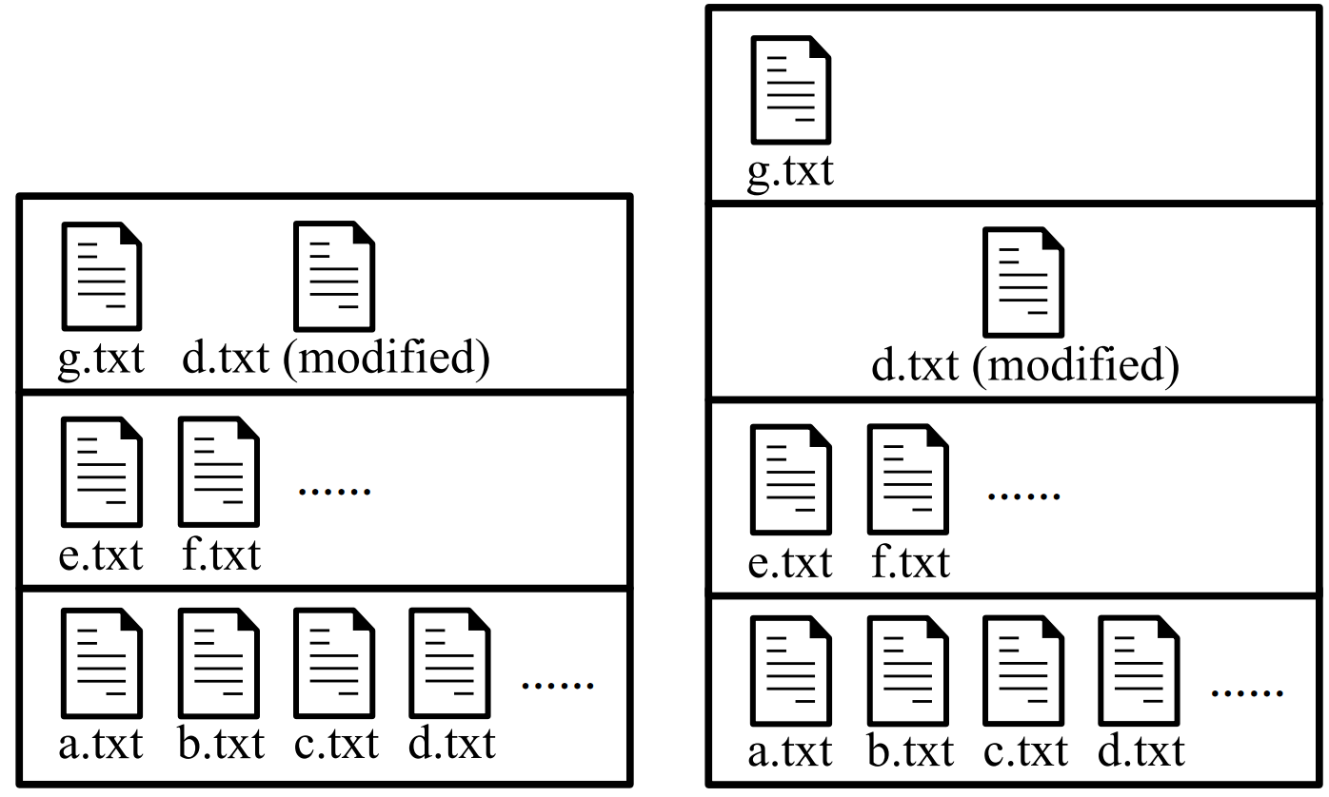

Image Reconstruction
Limited layer sharing
Image reconstruction:
Regrouping the files to create identical layers towards effective layer sharing.
High similarity of layers
Questions:
How many layers in the reconstructed image?
Which layer does each file belong to?
What is the order of layers?
An example of image reconstruction
9
Notes:
左侧两个motivation和前面测量的结论相对应
问题和后面挑战的逻辑

Slide 10
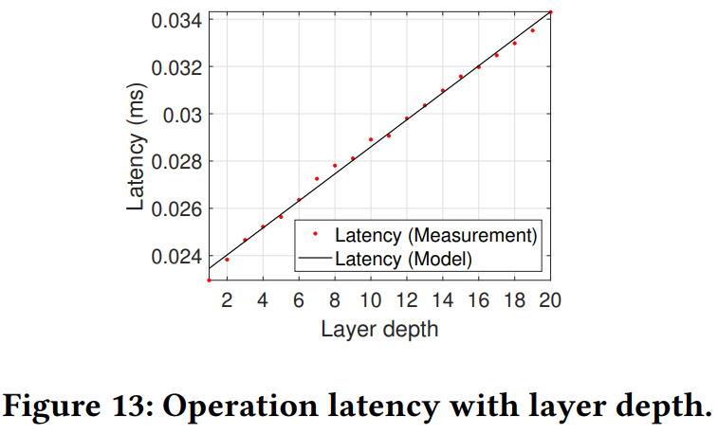

Challenge#1
How many layers in the image affects the operation latency.
$$\text{Latency}\text{ = 0.001526× }\text{Layer} \text{depth} \text{+} \text{0.3087}$$
How to trade off the storage and the operation overhead?
10

Slide 11
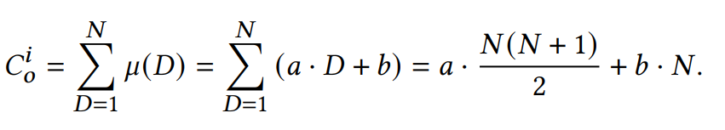
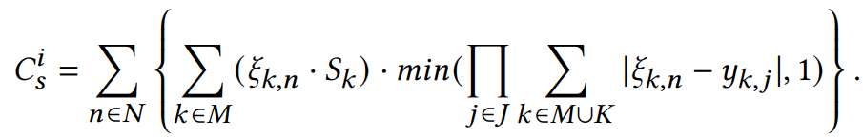
Operation and Storage Weighted Cost
Optimization goal: min Cost = $α∙$ operation cost + $β ∙$ storage cost
Operation cost：summary latency of each layer
Latency of each layer
Storage cost: incremental storage of unique layers
Layer size
Whether the layer is unique
11

Slide 12
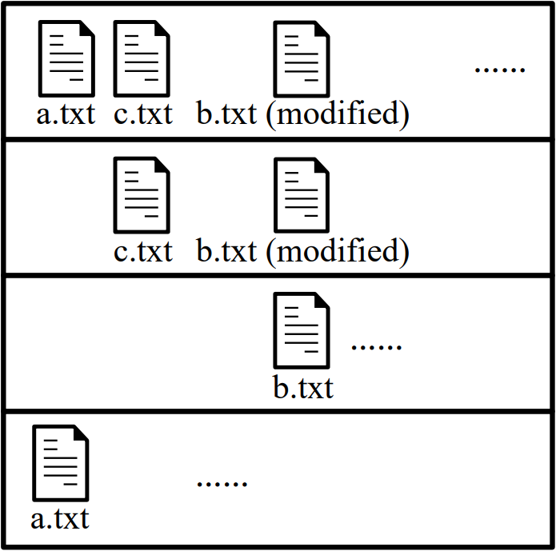
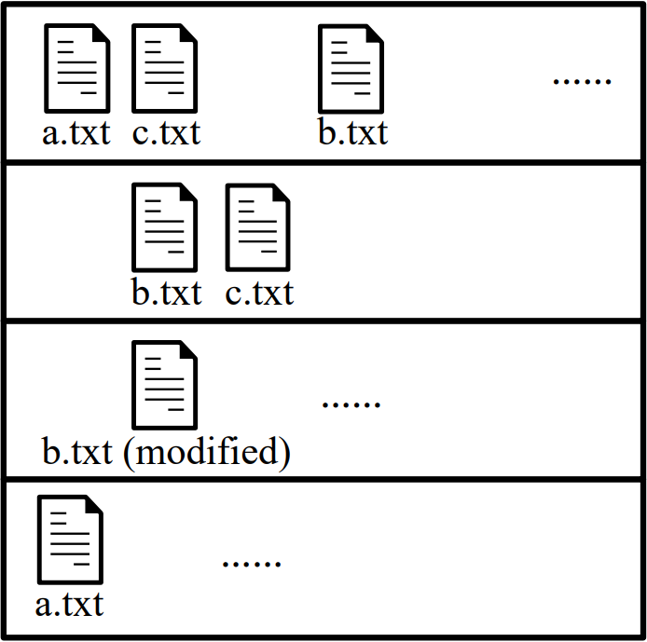
Challenge#2
Partial files have dependency. (Such as b.txt (modified) and b.txt.)
File location and layer order affect the mount view of image and make it invalid.
Mount view
Image layers
File Regrouping
How to guarantee the image validity?
12

Slide 13
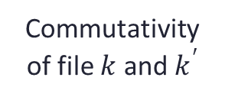
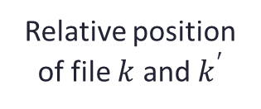
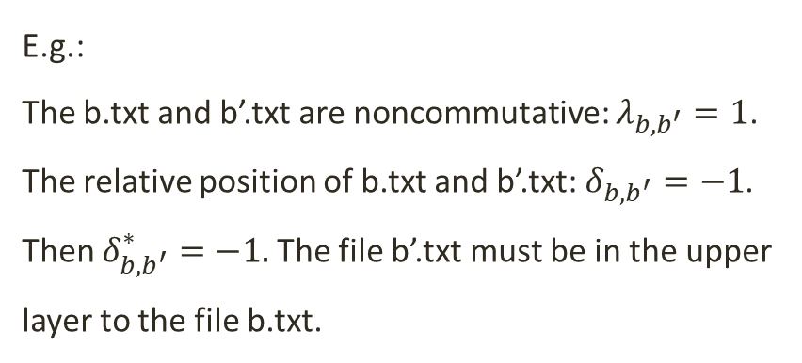

Commutativity Model
If two files have dependency, they are defined as noncommutative.
The relative layer position of noncommutative file pairs cannot be changed.
Commutativity constraint:
Image
Layer3: c.txt, b’.txt (modified on b.txt), …
Commutativity of file $k$ and $k^{′}$
Layer2: b.txt, …
Layer1: a.txt, …
$$δ_{k,k^{′}}∙λ_{k,k^{′}}=δ_{k,k^{′}}^{∗}∙λ_{k,k^{′}}$$
E.g.:
The b.txt and b’.txt are noncommutative: $λ_{b,b^{′}}=1$.
The relative position of b.txt and b’.txt: $δ_{b,b^{′}}=−1$.
Then $δ_{b,b^{′}}^{∗}=−1.$ The file b’.txt must be in the upper layer to the file b.txt.
Relative position of file $k$ and $k^{′}$
Relative position after reconstruction
13

Slide 14
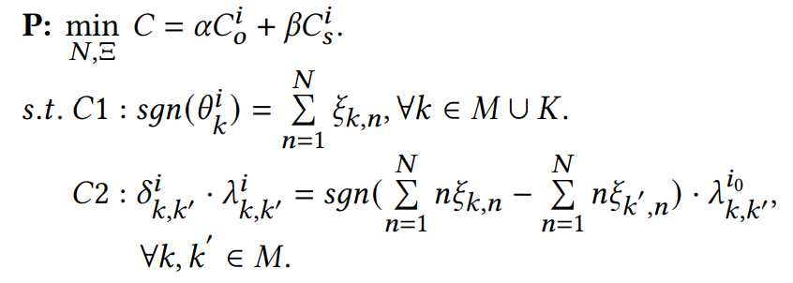
Problem Formulation
Objective: Minimize the weighted operation cost and storage cost
Constraint 1: file consistency
Constraint 2: file commutativity
14

Slide 15
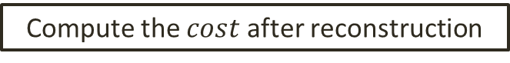
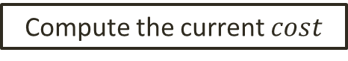
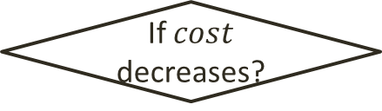
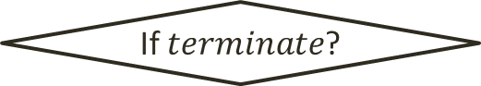
Similarity-aware Image Reconstruction Algorithm
Initialize
Compute the current $cost$
Compute the similarity
YES
If $terminate$?
end
Output metadata of the reconstructed image
NO
Choose the source layer
Regroup files for each layer
Choose the target layer
Select target layer only within the repository
Compute the $cost$ after reconstruction
Create sharing layer with the identical files from the source layer and the target layer
NO
If $cost$ decreases?
YES
Keep layer
unchanged
Make layer
reconstruction
15

Slide 16


Evaluation
Settings
Server: eight core Intel Xeon Processor, 2.5GHz, 11GB RAM
dataset: ImageNET
Baselines
Greedy Offline Image Reconstruction Algorithm (GOIRA).
Layered Images from Docker Hub (LIDH).
One-File-Per-Layer (OFPL).
16
Notes:
dataset

Slide 17
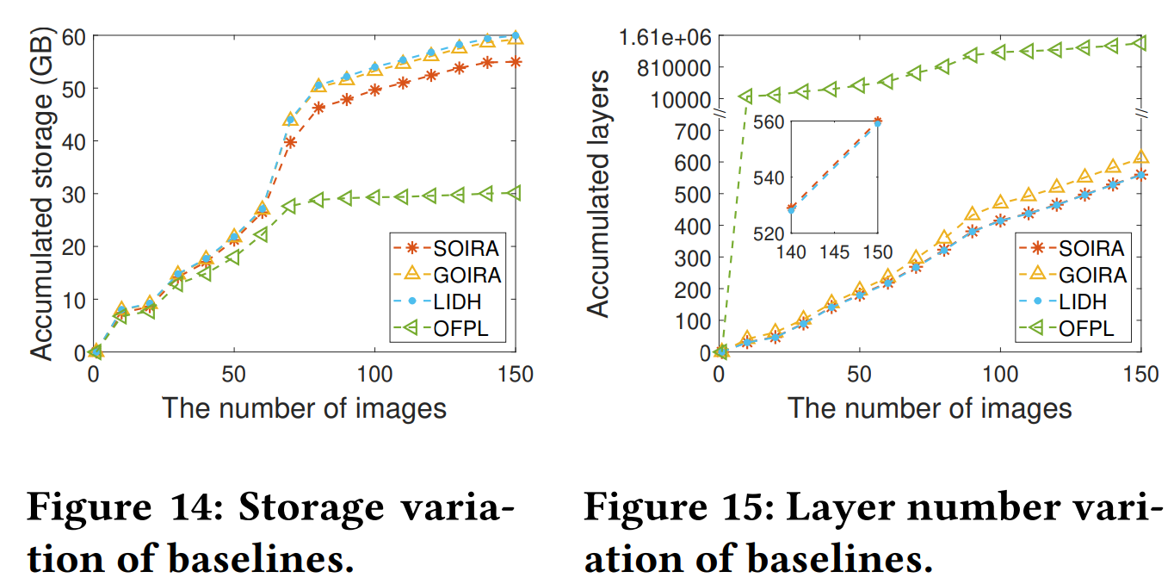
Storage and Operation Overhead
(150,1413629)
OFPL: The least layer storage, the worst performance in layer number.
GOIRA: 1.3% storage saving, 7.3% increase of layer number.
SOIRA: 10% storage saving, single-digit growth of layer number.
17

Slide 18
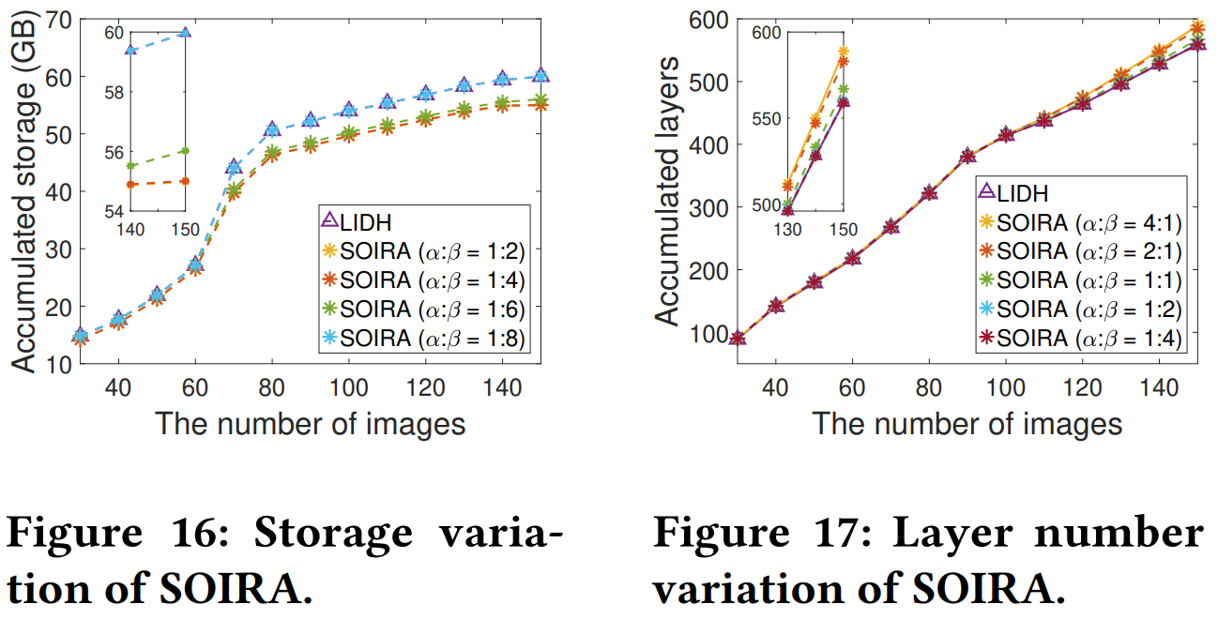
Storage and Operation Overhead
With higher 𝛼:𝛽 , SOIRA prefers lower storage consumption.
Different storage saving can be achieved by adjusting 𝛼:𝛽.
18

Slide 19
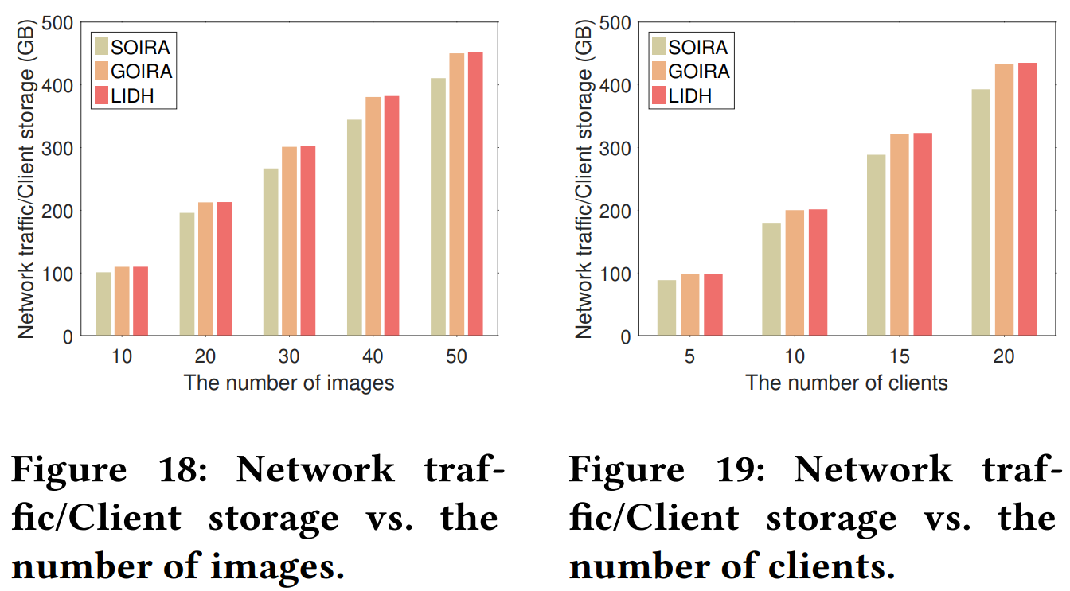
Network Traffic and Client Storage
8.3% saving compared with GOIRA,
8.8% saving compared with LIDH.
Client number is 10.
Each client downloads 20 images.
More clients or downloaded images, more traffic saving.
19

Slide 20
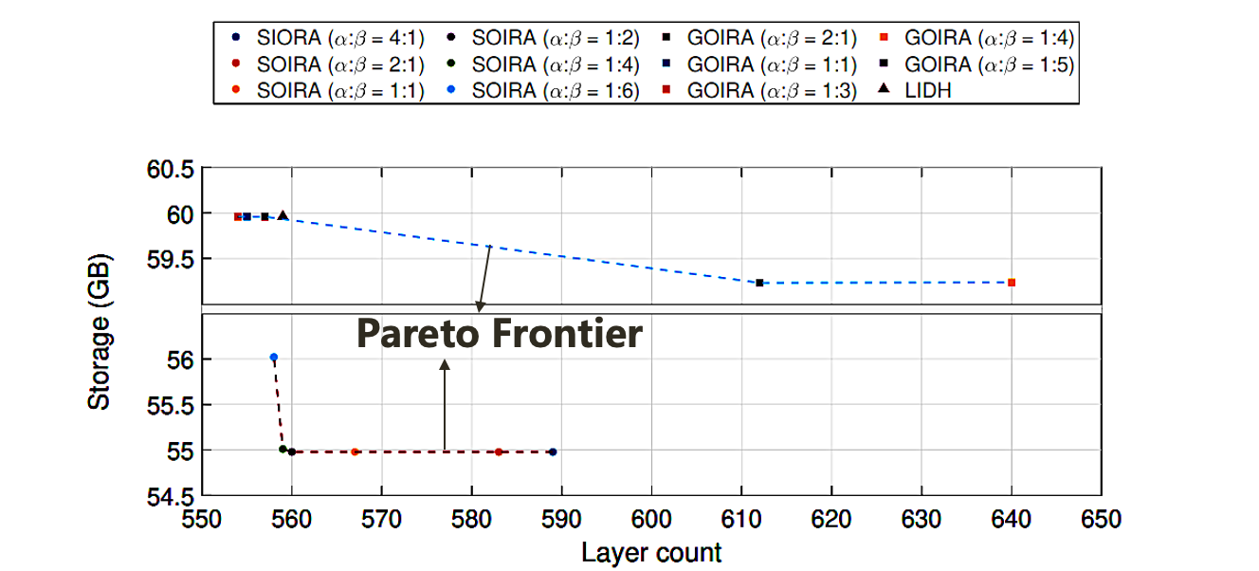
Storage and Operation Overhead Trade-off
The layer count and storage run in the opposite direction.
An improved Pareto frontier and better performance is achieved by our SOIRA.
20

Slide 21
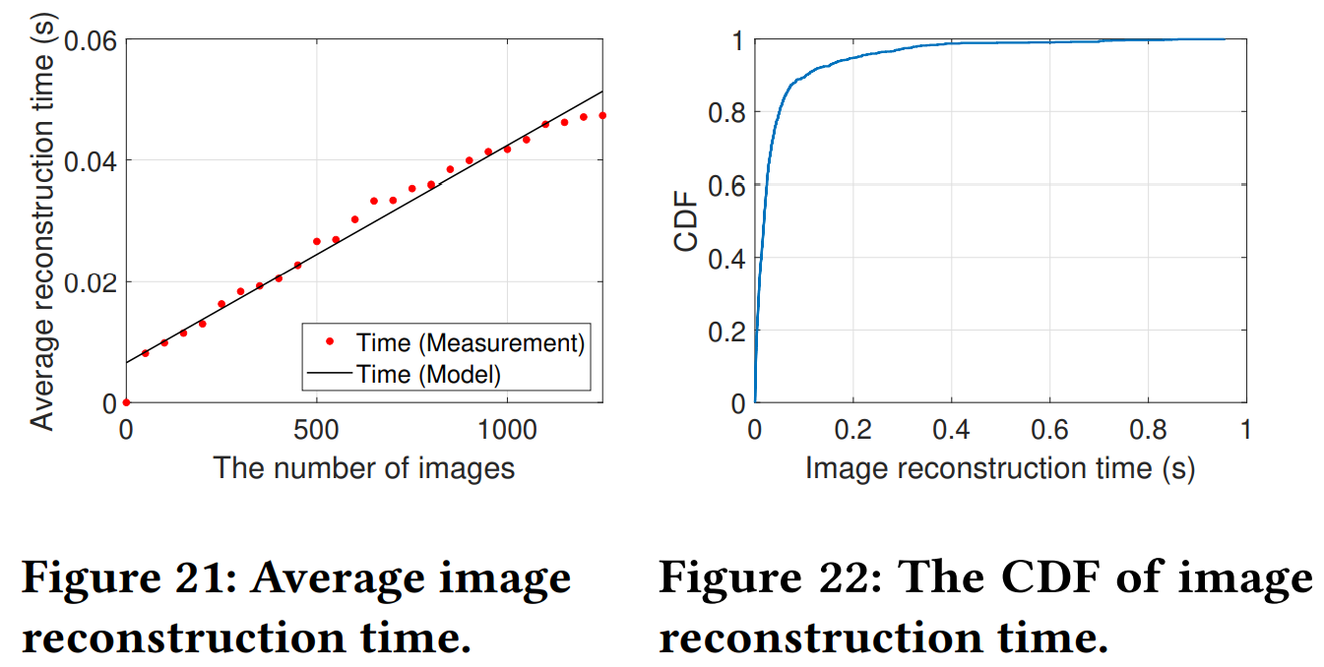
Image Reconstruction Time
(0.05,0.8)
The time goes through a slight and tolerable time increase with the expansion of the image number.
Around 80% images consume reconstruction time less than 0.05s.
21

Slide 22

Summary
Evaluation of content addressable storage to reveal the file redundancy.
Quantification and measurement of layer similarity.
Image reconstruction towards effective layer sharing to save both storage and network resource consumption.
Thanks for your listening!
Q&A
Sisi Li (sisili@bupt.edu.cn)
22

